Slide 1
How PSSA Can Better Serve You

Slide 2
How PSSA Can Better Serve You
Providing Snow Condition Reports
524 Responses- 5 Empty
66%
321
300
53%
257
200
41%
191
25%
124
24%
117
21%
22%
103
100
98
9%
41
7%
33
10%
50
8%
41
8%
37
3%
16
2%
8
1%
7
0
By Alerts via Texts
By Facebook
By Webcams
Extremely Beneficial
Very Beneficial
Moderately Beneficial
Slightly Beneficial
Not At All Beneficial

Slide 3
How PSSA Can Better Serve You
Coordinating Help with Trail Maintenance/Trail Building
515 Responses- 14 Empty
300
54%
273
55%
276
250
200
32%
161
30%
152
150
100
50
9%
4%
19
10%
45
2%
9
48
3%
17
1%
6
0
Trail Maintenance
Trail Building
Extremely Beneficial
Very Beneficial
Moderately Beneficial
Slightly Beneficial
Not At All Beneficial

Slide 4


How PSSA Can Better Serve You
Coordinating Help Working with Governmental Agencies
512 Responses- 17 Empty
400
68%
343
300
60%
62%
62%
297
54%
263
298
296
200
26%
127
26%
127
23%
110
23%
111
21%
106
100
13%
65
8%
38
9%
46
4%
20
4%
21
9%
43
4%
18
9%
42
4%
18
3%
13
1%
4
1%
5
2%
9
2%
11
2%
11
0
DCNR
State Game Commission
Penn DOT
Legislators
Local Government O cials
Extremely Beneficial
Very Beneficial
Moderately Beneficial
Slightly Beneficial
Not At All Beneficial

Slide 5
How PSSA Can Better Serve You
Offering Group Trips In State to what point(s) of interest?
126 Responses- 403 Empty
Data | Responses
North Central | 37
Allegheny National Forest, County, and Park | 21
Anywhere in PA | 17
Erie Area | 12
North East | 13
Laurel Highlands | 8
Central | 3

Slide 6
How PSSA Can Better Serve You
Offering Group Trips out of State to what point(s) of interest?
133 Responses- 396 Empty
Data | Responses
Maine | 34
Michigan | 32
Adirondacks Area/Tughill | 24
Canada | 18
Jackson Hole/Yellowstone Park/Montana | 17
Western New York | 15
Vermont | 13
Anywhere | 9
New Hampshire = 5, Wisconsin =3, South Dakota = 1, North Dakota = 1 | 10

Slide 7

How PSSA Can Better Serve You
Providing Training Classes
507 Responses- 22 Empty
64%
310
300
53%
256
200
40%
38%
34% 185
165
194
32%
155
27%
130
19%
21%
103
100
94
18%
87
10%
50
13%
61
7%
32
2%
12
6%
29
3%
15
2%
12
2%
9
5%
23
2%
10
0
Snowmobile Safety Classes
Groomer Driver Training
Private Landowner Agreements
Grant Writing
Extremely Beneficial
Very Beneficial
Moderately Beneficial
Slightly Beneficial
Not At All Beneficial

Slide 8
How PSSA Can Better Serve You
Other Training Not Listed Above
27 Responses- 502 Empty
Data | Responses
First Aid to include CPR, winter survival, search and rescue, GPS and coordinating with EMS | 6
Minor snowmobile repairs, regular snowmobile maintenance | 4
Best practices for trail building, trail maintenance and signage | 3
Train the trainer for the DCNR Snowmobile Safety Course | 2
Landowner, public land, and neighboring businesses communications and agreements | 2
Ski resort relationships and other winter destination establishments agreements | 2
Deep snow and mountain area riding | 1
Ski patrol skills | 1
How to be a PSSA board director | 1

Slide 9
How PSSA Can Better Serve You
Coordinating Help with Fundraising Events
502 Responses- 27 Empty
200 39%
195
34%
170
150
100
18%
92
50
7%
34
2%
11
0
Extremely Beneficial
Very Beneficial
Moderately Beneficial
Slightly Beneficial
Not At All Beneficial
Extremely Beneficial
Very Beneficial
Moderately Beneficial
Slightly Beneficial
Not At All Beneficial

Slide 10
How PSSA Can Better Serve You
Attendance by your PSSA Regional Director at your club meeting/events
491 Responses- 38 Empty
41%
203
200
150
25%
123
25%
121
100
50
7%
33
2%
11
0
Extremely Beneficial
Very Beneficial
Moderately Beneficial
Slightly Beneficial
Not At All Beneficial
Extremely Beneficial
Very Beneficial
Moderately Beneficial
Slightly Beneficial
Not At All Beneficial

Slide 11
How PSSA Can Better Serve You
Development of dependable and adequate funding for clubs that groom and maintain trails
503 Responses- 26 Empty
400
68%
342
300
200
23%
117
100
7%
33
1%
7
1%
4
0
Extremely Beneficial
Very Beneficial
Moderately Beneficial
Slightly Beneficial
Not At All Beneficial
Extremely Beneficial
Very Beneficial
Moderately Beneficial
Slightly Beneficial
Not At All Beneficial

Slide 12
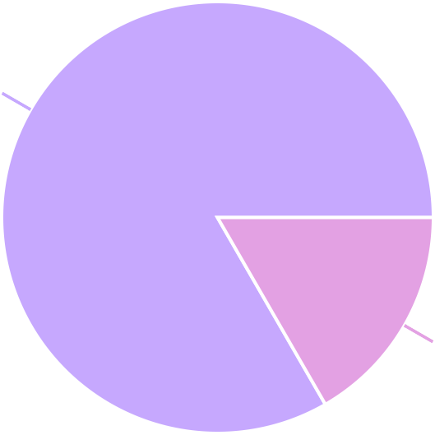
How PSSA Can Better Serve You
Would you be in favor of increasing snowmobile registration fees to increase the number of groomed trails and trail amenities in PA?
522 Responses- 7 Empty
YES 83%
435
87
NO 17%
YES
NO

Slide 13
How PSSA Can Better Serve You
Would you be in favor of a separate registration fee for riding on the PA State Game Lands if it meant increased riding opportunities?
522 Responses- 7 Empty
YES 67%
349
173
NO 33%
YES
NO

Slide 14

How PSSA Can Better Serve You
Have you or anyone in your snowmobile club spoken to an elected o cial regarding your snowmobiling opportunities and/or experiences in the past year?
496 Responses- 33 Empty
No 66%
329
167
Yes 34%
No
Yes

Slide 15
How PSSA Can Better Serve You
If you or anyone in your snowmobile club have spoken to an elected or government o cial regarding your snowmobiling opportunities and/or experiences, who did you speak with? Please indicate all answers that apply.
294 Responses- 339 Empty
Local elected o cal 49%
144
1
_{S}L_{t}o_{a}c_{t}a_{e}l and _{f}s_{e}ta_{d}t_{era}e_{l}lec_{le}te_{ct}d_{e}o_{d} _{o} ca_{c}ls_{als}
0%
31
Federal elected o cial 11%
117
State elected o cial
40%
Local elected o cal
State elected o cial
Federal elected o cial
State and federal elected o cals
Local and state elected o cals

Slide 16
How PSSA Can Better Serve You
How would you like PSSA to communicate with you? Please indicate all that apply.
964 Responses- 25 Empty
Email 41%
394
Facebook
25%
245
119
USPS Mail 12%
206
PSSA Website 21%
Email
Facebook
PSSA Website
USPS Mail

Slide 17
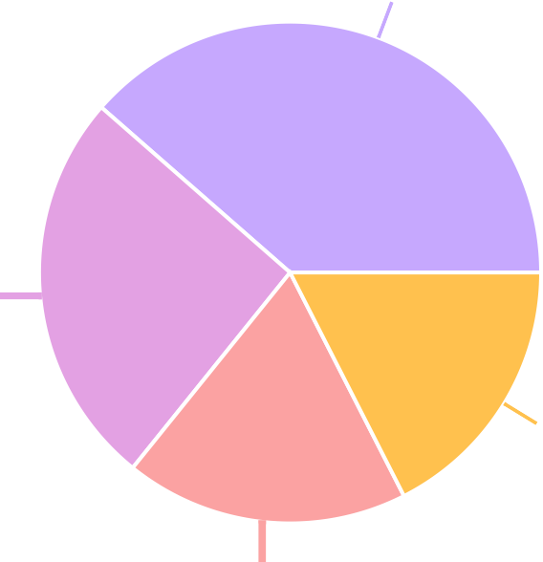
How PSSA Can Better Serve You
How would you like to read your Keystone Snowmobiler? Please indicate all that apply.
760 Responses- 22 Empty
Email - please provide your email address at the end of this survey. 39%
293
USPS Mail
26%
195
133
PSSA Website 18%
139
Facebook
18%
Email - please provide your email address at the end of this survey.
USPS Mail
Facebook
PSSA Website

Slide 18

How PSSA Can Better Serve You
Would you be willing to pay for a subscription to the Keystone Snowmobiler to receive a printed copy by USPS mail?
513 Responses- 16 Empty
NO 57%
293
220
YES 43%
NO
YES

Slide 19
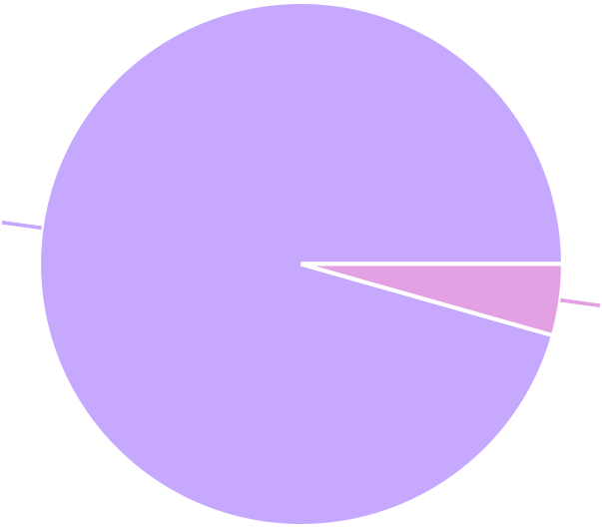
How PSSA Can Better Serve You
Are you completing this survey for a snowmobile club or for yourself as an individual or family?
523 Responses- 6 Empty
Completing for myself and/or my family
96%
500
23
Completing for my snowmobile club 4%
Completing for myself and/or my family
Completing for my snowmobile club

Slide 20
How PSSA Can Better Serve You
Name of Clubs Completing Survey:
26 Responses- 503 Empty
Clubs that took the survey as a club, not an individual or family | Responses
Glendale Lake Snowmobile Club | 7
NEP Sno Trails | 3
A.C.E. Snowmobile Club, Marienville Trail Riders, PA Snow Seekers, Scagburners SC, Presque Isle SC | 2
Chatauqua Lake SC, Potter County SC, Southern Potter SC, Pymatuning Trailblazers, Wales Sno-Drifters, Willow Creek SC, T Vac, Test | 1
Total Club Reponses | 28

Slide 21
How PSSA Can Better Serve You
Number of members:
17 Responses- 512 Empty
Club | Number of Members
Chatauqua Lake Snowmobile Club | 1368
Glendale Lake Snowmobile Club (4 reponses = 125, 181, 181, 200), Southern Potter Snowmobile Club | 125-200
Scagburners Snowmobile Club | 105
A.C.E. Snowmobile Club | 100
NEP Sno Trails | 100
Presque Isle Snowmobile Club, Marienville Trail Riders, Wales Sno-Drifters | 80
PA Snowseekers (2 responses = 50, 66) | 50-66
Pymatuning Trailblazers | 50
T Vac | 10

Slide 22
How PSSA Can Better Serve You
County where club is located:
23 Responses- 506 Empty
County | Clubs Responding
Cambria | 2
Wayne | 2
Forest | 2
Erie | 2
Chautauqua | 1
Warren | 1
Potter | 2
Crawford | 1
McKean | 1

Slide 23

How PSSA Can Better Serve You
Is your club a member of PSSA?
22 Responses- 507 Empty
YES 100%
22
YES

Slide 24
How PSSA Can Better Serve You
Has your club received a PSSA Mini Grant in the past?
18 Responses- 511 Empty
YES 67%
12
2
Our club would like information about Mini Grants. 11%
4
NO 22%
YES
NO
Our club would like information about Mini Grants.

Slide 25
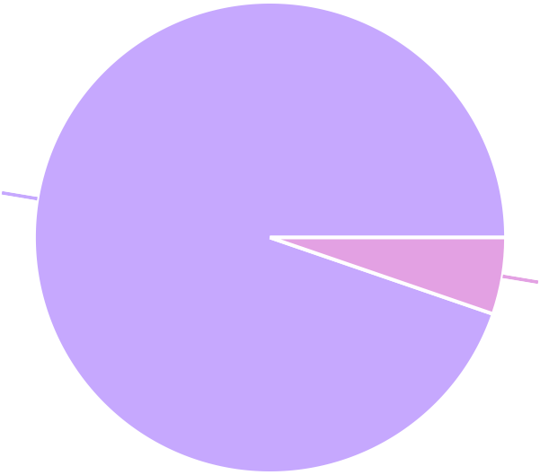
How PSSA Can Better Serve You
Are PSSA Mini Grants important to your club?
19 Responses- 510 Empty
YES 95%
18
1
NO 5%
YES
NO

Slide 26
How PSSA Can Better Serve You
What can PSSA do to assist your club in it's mission? Please share any closing thoughts you have for PSSA.
9 Responses- 520 Empty
Data | Responses
Get the PA Game Commission to open game lands to snowmobiling | 4
Better method/more adequate/more dependable method for clubs to be funded by DCNR | 3
Do better coordination with the mini grants | 2
Trails trails trails | 1
Assistance to be able to groom trails on Allegheny National Forest | 1
Finish the state wide map and get it in a cellphone format like other states have | 1
Work with PA highway agencies for use of road right of ways to connect gaps in trail systems | 1

Slide 27
How PSSA Can Better Serve You
Number of snowmobiles in your household:
498 Responses- 31 Empty
Data | Responses
2 | 207
3 | 99
1 | 77
4 | 65
5 | 27
6 | 16
7 | 9
10 | 5
9 | 4

Slide 28
How PSSA Can Better Serve You
Average number of yearly miles you ride :
486 Responses- 43 Empty
Data | Responses
1000 | 95
500 | 83
1500 | 51
2000 | 28
300 | 24
1200 | 24
600 | 23
200 | 22
400 | 19

Slide 29
How PSSA Can Better Serve You
Years of snowmobile riding experience :
499 Responses- 30 Empty
Data | Responses
30 | 62
40 | 53
25 | 45
20 | 40
35 | 38
50 | 31
15 | 29
45 | 29
10 | 25

Slide 30
How PSSA Can Better Serve You
County of residence:
491 Responses- 38 Empty
Data | Responses
Erie | 47
Cambria | 23
Wayne | 21
Lackawanna and Lancaster = 19 each | 38
Blair, McKean, Westmoreland = 17 each | 51
Allegheny, Butler, and Lebanon = 15 each | 45
Berks and York = 14 each | 28
Bucks, Centre, Lycoming, Montgomery, and Somerset = 11 each | 55
Clearfield = 8, Northampton = 8, Schuylkill = 8, Susquehanna = 9, and Warren =8 | 41

Slide 31
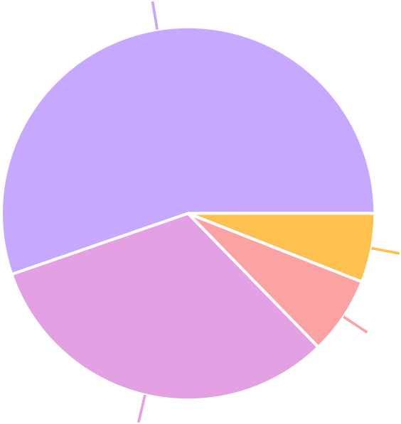
How PSSA Can Better Serve You
Age group
519 Responses- 32 Empty
50-69
55%
287
31
18-29
6%
35
70+
7%
166
30-49
32%
50-69
30-49
70+
18-29

Slide 32
How PSSA Can Better Serve You
What type of snowmobiler do you consider yourself to be? Indicate all that apply to you.
724 Responses- 32 Empty
Snow chaser - I travel to other areas of PA, to other states, or other nations
50%
363
₂ All of the above
0%
116
Camper - I travel to a camp to ride. 16%
243
Local - I ride the trails and fields around my home.
34%
Snow chaser - I travel to other areas of PA, to other states, or other nations
Local - I ride the trails and fields around my home. All of the above
Camper - I travel to a camp to ride.

Slide 33

How PSSA Can Better Serve You
Are you a member of a snowmobile club?
489 Responses- 40 Empty
YES - If YES, please enter name of club you belong to:
68%
334
155
NO 32%
YES - If YES, please enter name of club you belong to:
NO

Slide 34
How PSSA Can Better Serve You
Clubs Joined by Survey Responders:
323 Responses- 206 Empty
Clubs identified by individual/family responses for membership | Responses
NEP Snotrails | 53
Glendale Lake Snowmobile Club | 27
God’s Country Black Forest and Presque Isle Snowmobile Club | 19
Laurel Highlands Snowmobile Club and McKean Snowriders | 14
Chatauqua Lake Snowmobile Club | 14
Wales Sno Drifters and Potter County Snowmobile Club | 14
PA Grand Canyon Snowmobile Club | 15
Willow Creek Snowmobile Club | 10
Saint Mary’s Snowmobile Association | 7

Slide 35
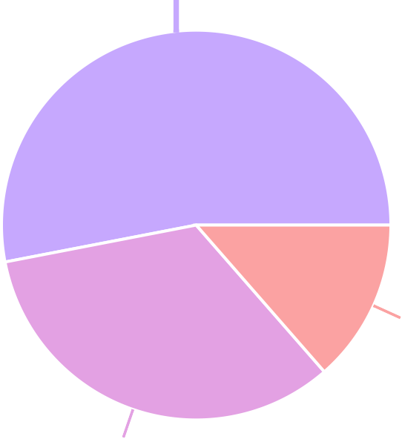
How PSSA Can Better Serve You
Are you a member of PSSA?
494 Responses- 35 Empty
YES 53%
262
67
I would like to join. Please send me information to join PSSA. 14%
165
NO 33%
YES
NO
I would like to join. Please send me information to join PSSA.

Slide 36
How PSSA Can Better Serve You
What can PSSA do to assist you in your pursuit of snowmobile riding experiences? Please share any closing thoughts you have for PSSA.
189 Responses- 340 Empty
Data | Responses
Link trails to each other and to New York gas and food along the state border | 22
MAKE IT SNOW! | 18
Create a link to get statewide accurate trail access and conditions and timely snow conditions. | 16
Negative comments on plowing joint use trails/roads in the Allegheny National Forest and the state forest trails | 17
Better maps and get it in a cellphone format like other states have available =9 responses / Positive comments on what PSSA does = 8 responses | 17
Reciprocity with other states =4 / Work with municipalities to use road shoulder for trail =6 / More web cams =4/ Work with game commission for access on game lands = 4 | 18
Training course for new riders / State of PA process for instant registration for snowmobiles = 2 items with 3 responses | 6

Slide 37
Thank You!
How PSSA Can Better Serve You

